Slide 1

PROJECT REPORT on RECOMMENDATION SYSTEM USING APRIORI ALGORITHM
Under the guidance of
Dr. Anurag Jain
Assistant Professor(CIT)
Department of Virtualisation
School of Computer Science
Submitted by -
Anshika Sharma Divyanshu Singh Kaustavdeep Goswami
(R610217003) (R610217007) (R610217010)

Slide 2

TABLE OF CONTENTS
Serial no. | Title
1 | Abstract
2 | Introduction
3 | Problem Statement
4 | Literature Review
5 | Objective
6 | Methodology
7 | System requirements
8 | Schedule (Pert Chart)
9 | References

Slide 3
ABSTRACT
The world now stands on data. From morning till night each and every of our work is related to data and the data is stored in the data warehouse. Unfortunately, majority of our data remains unused. The trend has now changed. Today, most of the data is analyzed and processed to gain certain knowledge to profit the company.
Data mining is the process of analyzing hidden patterns of data according to different perspectives for categorization into useful information, which is collected and assembled in common areas, such as data warehouses, for efficient analysis, data mining algorithms, facilitating business decision making and other information requirements to ultimately cut costs and increase revenue.
Data mining programs analyze relationships and patterns in data based on user’s request. Data mining can be a cause for concern when a company uses only selected information, which is not representative of the overall sample group, to prove a certain hypothesis.
To sum up, data mining is the eye of our future, without it the world is blind.
Keywords: Data Mining, Apriori algorithm, Market-basket analysis, Association rule,

Slide 4
INTRODUCTION
The process of digging through data to discover hidden connections and predict future trends has a long history. Sometimes referred to as "knowledge discovery in databases".
Data mining is the process of finding anomalies, patterns and correlations within large data sets to predict future outcomes. Using a broad range of techniques, we can use information to increase revenues, cut costs, improve customer relationships and reduce risks. The more complex the data sets, the more potential there is to uncover relevant insights. Data can be mined whether it is stored in flat files, spreadsheets, database tables, or some other storage format. The important criteria for the data is not the storage format, but its applicability to the problem to be solved.
Data mining is accomplished by building models. A model uses an algorithm to act on a set of data. The notion of automatic discovery refers to the execution of data mining models.
The main purpose of data mining process is to discover those records of information and summarize it in a simpler format for the purpose of increasing customer loyalty, find hidden profitability, finding patterns and increasing customer satisfaction.

Slide 5
PROBLEM STATEMENT
Once it is known that customers who buy one product are likely to buy another, it is possible for the company to market the products together, or to make the purchasers of one product the target prospects for another.
If customers who purchase tomatoes are already likely to purchase onions, they’ll be even more likely to buy it, if there happens to be an onion crate just beside the tomato aisle.
By targeting customers, the effectiveness of marketing can be significantly increased – regardless of if the marketing takes the form of in-store displays, catalog layout design, or direct offers to customers.
This is the purpose of market basket analysis – to improve the effectiveness of marketing and sales tactics using customer data already available to the company.

Slide 6
LITERATURE REVIEW
Md. Mahamud Hasan, in his research paper said that, the data mining with market basket analysis method is implemented, where it can analyze the buying habit of the customers. Searching for frequent itemsets performed by Apriori algorithm to get the items that often appear in the database and the pair of items in one transaction.
Wan Faezah Abbas said that, Market-Basket Analysis is a process to analyze the habits of buyers to find the relationship between different items in their market basket. The discovery of these relationships can help the merchant to develop a sales strategy by considering the items frequently purchased together by customers.

Slide 7
OBJECTIVE -
To create Recommendation system based on Data Mining
To generate patterns and relationships among data elements, render relevant information, which may increase organizational revenue.
To analyze and draw conclusions about trends in consumer’s marketing behavior.

Slide 8
METHODOLOGY
Phase 1
Requirement analysis
Study concepts of Data Mining.
Study of Association rule mining and Apriori Algorithm.
Phase 2
Designing and development
Figuring out a mathematically optimized algorithm which will be used to develop Recommendation system.
Designing and development is further divided into various phases.
This phase starts with the input from the Requirement and Analysis phase which will clarify the problem definition which will lead this project to the model development phase where a model will be created and further lead to the designing of the algorithm.
After completion of the designing of the algorithm phase, the focus will shift on the analysis of the algorithms and their implementation in this project.

Slide 9
Phase 3
Coding
On receiving system design documents, the work is divided into modules/unit and distributed among the team members and actual coding is started. Since in this phase the code is produced so it is the main focus of the developers. This is going to be the longest phase in this project.
The implementation of this project starts in terms of writing program in the suitable programming language and developing error free executable program efficiently, this phase primarily focuses on coding.
Implementation
Creating a File(.txt) for data analysis.
Implementation of Apriori algorithm
Generating patterns and sets with Confidence value.
Applying market-basket analysis using association rule.
Analyzing and drawing conclusions of recommendation system with the required sets and patterns.
Phase 4
Testing
Manual Testing
Phase 5
Integrating and implementing all the above phases.

Slide 10
SYSTEM REQUIREMENTS
Software Requirements
Name of Component | Specification
_{Operating System} | Windows 98 and above, Linux
Compiler | GCC
Hardware Requirements
Name of Component | Specification
_{Processor} | _{Processor with speed of 500MHz}
_{RAM} | _{128 MB}
_{Hard Disk} | _{512 GB}

Slide 11
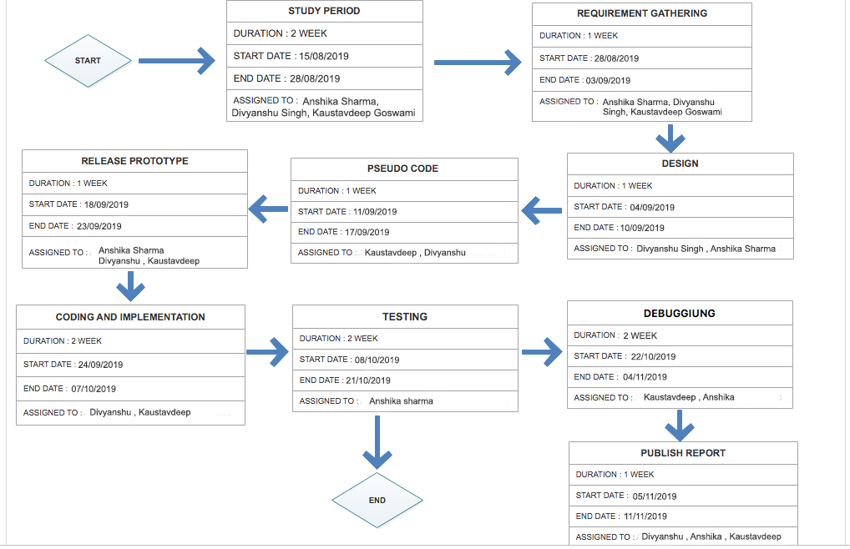
SCHEDULE

Slide 12

Thankyou

